Slide 1

N PALANI KARTHIK (22BCE1773)
SHARVESH RAJ G (22BCE5152)
OMPRAKASH (21BCE1950)

Slide 2
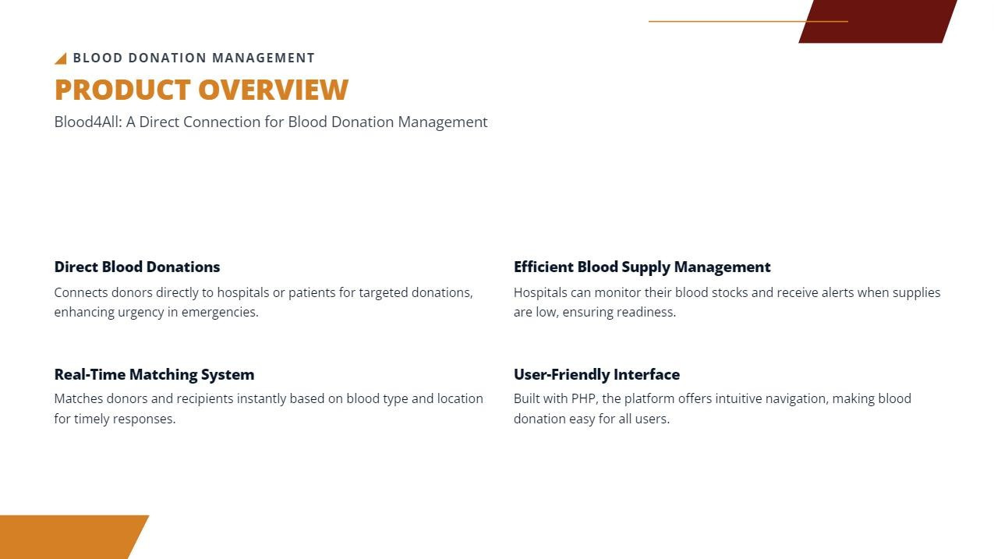

Slide 3
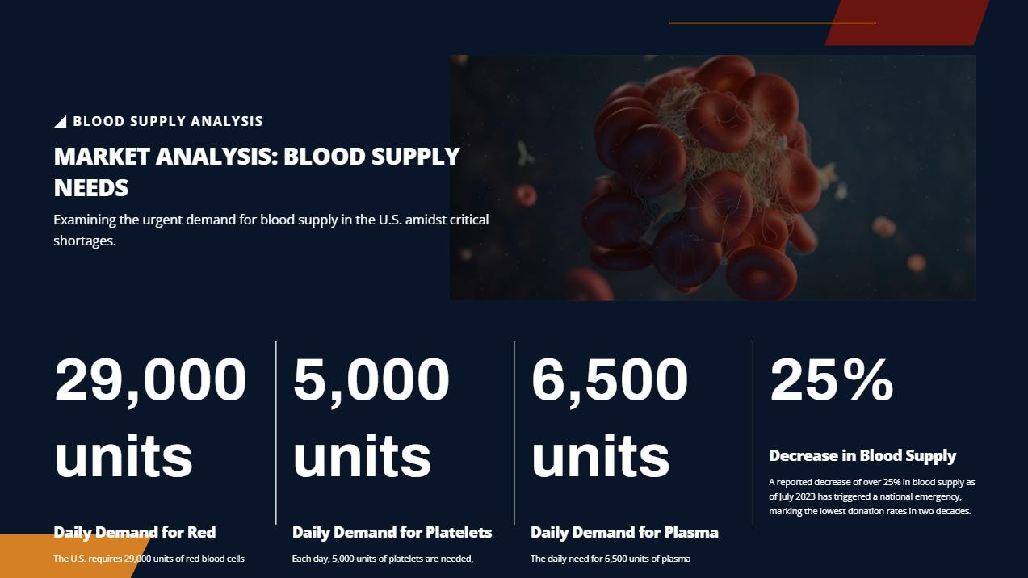

Slide 4
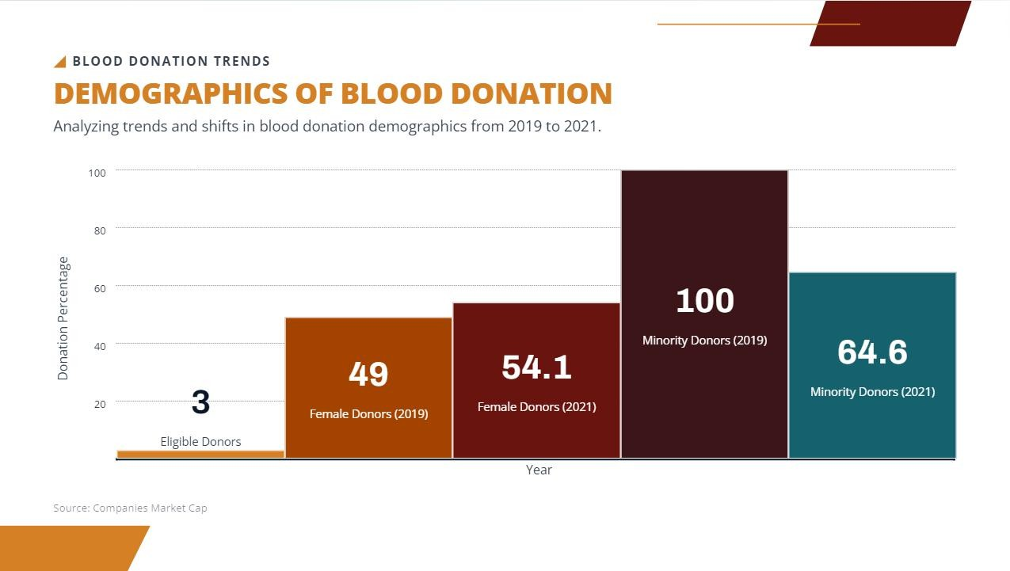

Slide 5


Slide 6


Slide 7
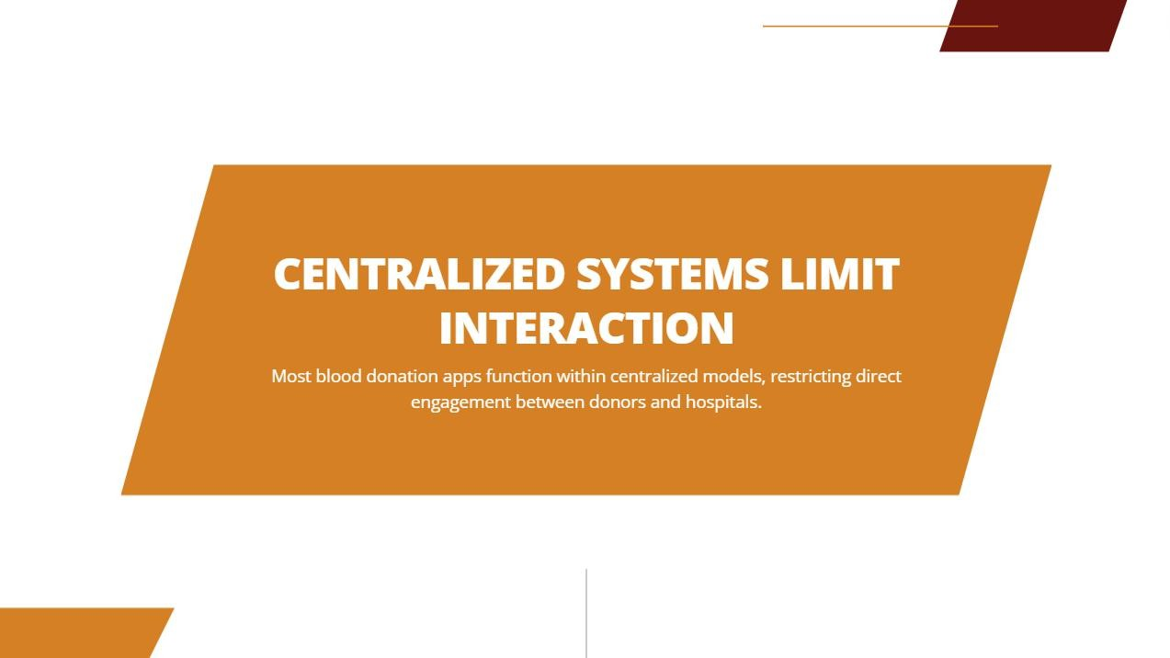

Slide 8
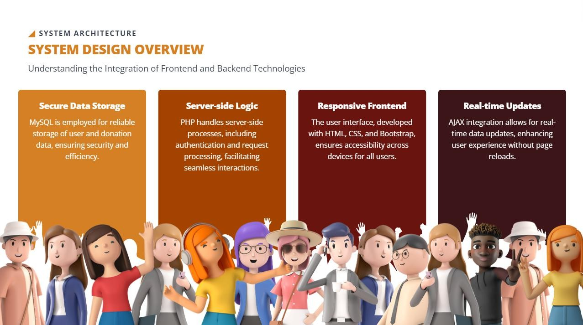

Slide 9
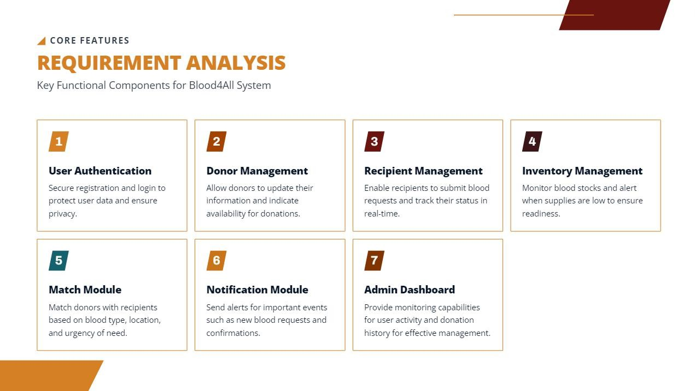

Slide 10
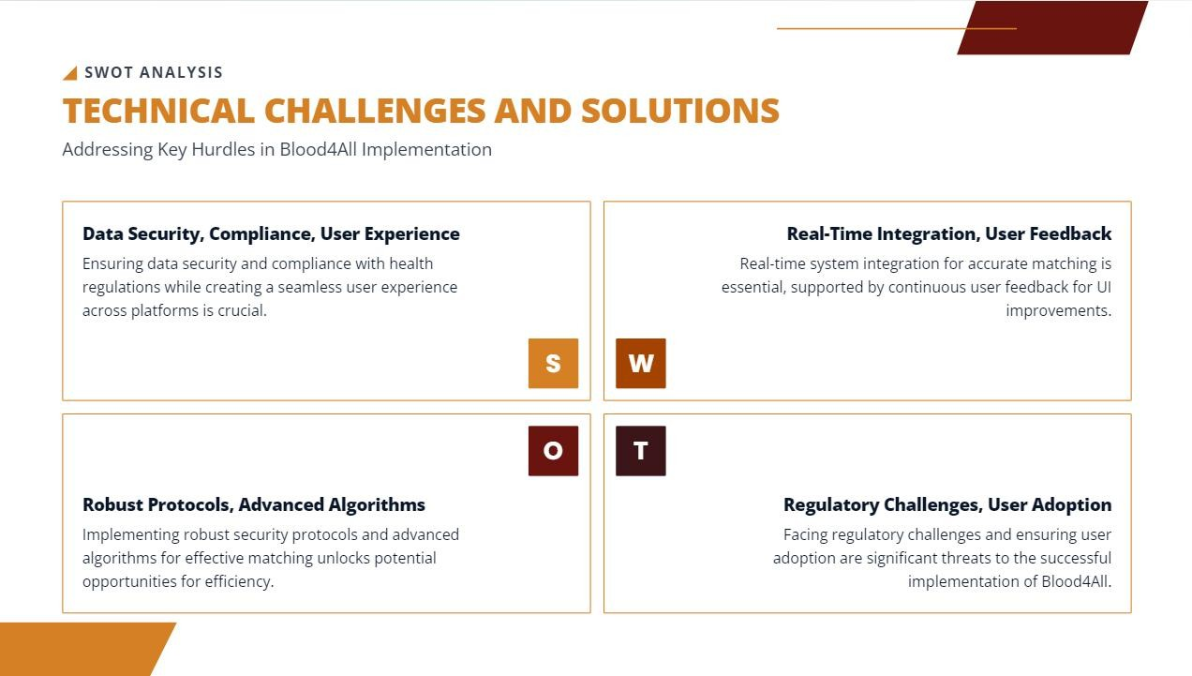

Slide 11
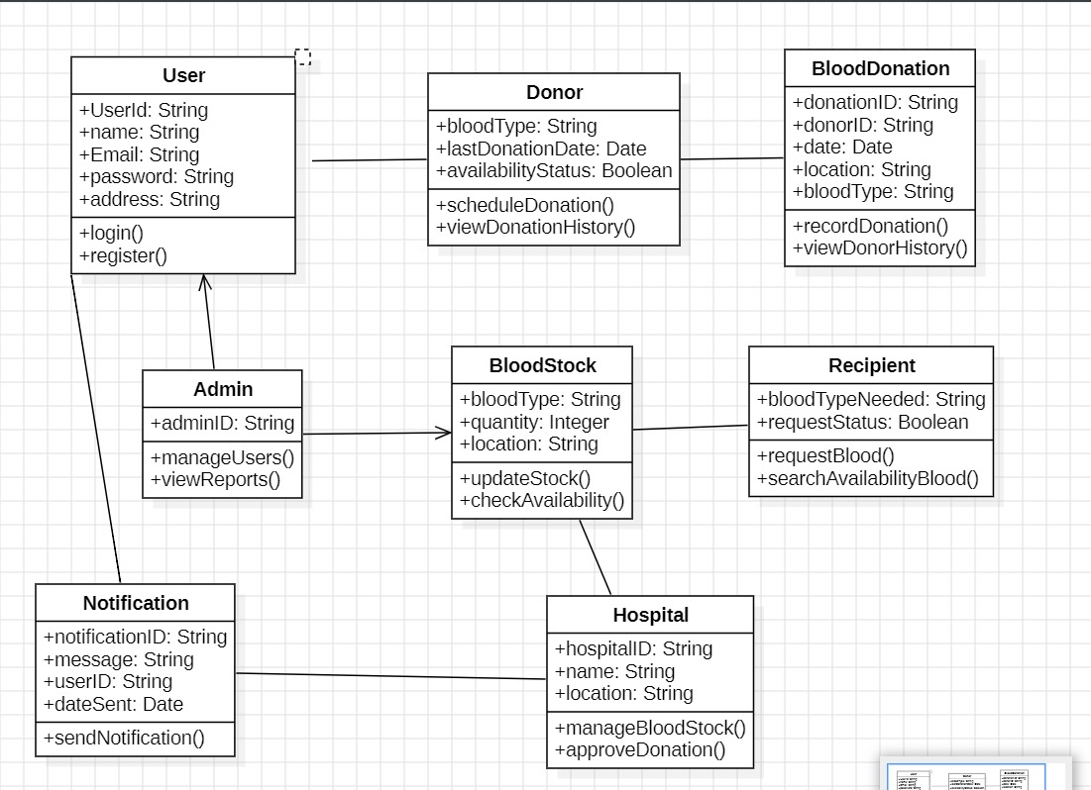
CLASS DIAGRAM :

Slide 12
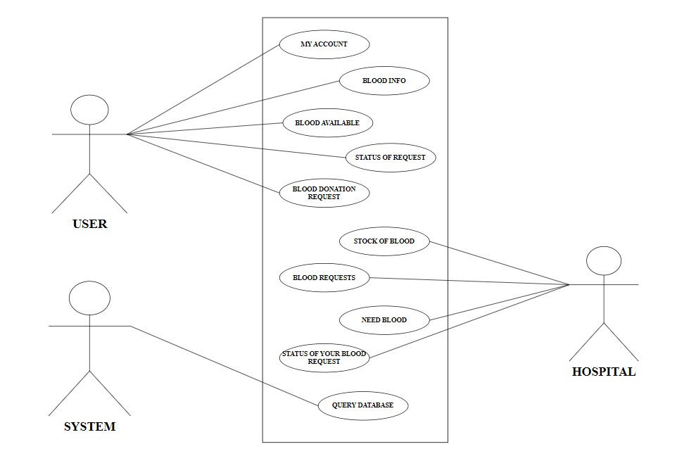
USE - CASE DIAGRAM:

Slide 13


Slide 14


